Slide 1
Language Models and Recurrent Neural Networks
Natural Language Processing
(based on revision of Chris Manning Lectures)

Slide 2
Announcement
TA announcements (if any)...

Slide 3
Suggested Readings
N-gram Language Models (textbook chapter)
The Unreasonable Effectiveness of Recurrent Neural Networks (blog post overview about RNN)
Sequence Modeling: Recurrent and Recursive Neural Nets (Sections 10.1 and 10.2)
On Chomsky and the Two Cultures of Statistical Learning (some cool stuffs about LM)

Slide 4
Language Modeling

Slide 5
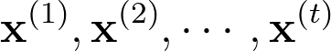
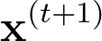
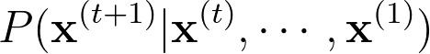
Language Modeling
Language Modeling is the task of predicting what word comes next
The student open their _______
More formally: given a sequence of words , compute the probability distribution of the next word
Such system is called a Language Model

Slide 6
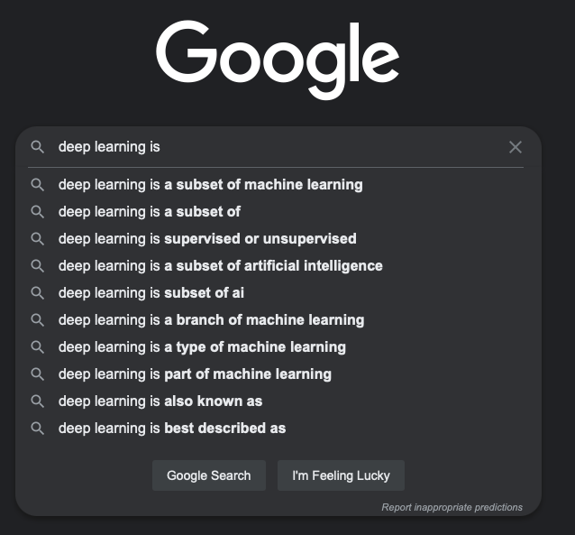
Language Modeling
We use LM everyday!

Slide 7
n-gram Language Models
The student open their _______
Question: How to learn a LM?
Answer (pre-Deep Learning era): learn an n-gram LM!
Definition: A n-gram is a chunk of n consecutive words
unigrams: “the”, “students”, “opened”, “their”
bigrams: “the students”, “students opened”, “opened their”
trigrams: “the students opened”, “students opened their”
4-grams: “the students opened their”
Idea: Collect statistics about how frequent different n-grams are

Slide 8
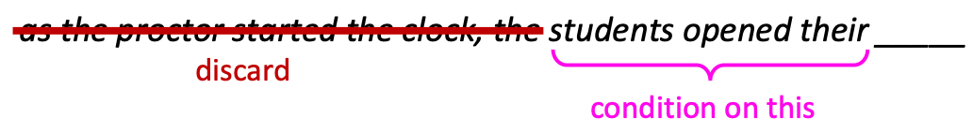
n-gram Language Models
Suppose we are learning a 4-grams LM.
For example, suppose that in the corpus:
“Students opened their” (i.e., n-1 grams) occurred 1000 times
“Students opened their books” (i.e., n grams) occurred 500 times
P(books | students opened their) = 0.5
“Students opened their exams” (i.e., n grams) occurred 100 times
P(exams | students opened their) = 0.1

Slide 9
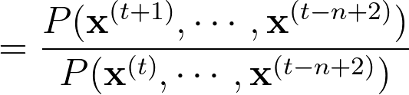
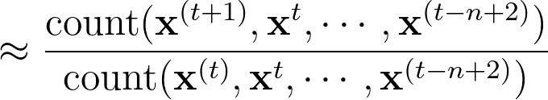
n-gram Language Models: Formally
First, we make a Markov assumption: depends only on the preceding n-1 words
Question: So what’s the probabilities?
Answer: Simply divide prob of n-gram by (n-1) gram
Question: But where to get these probabilities in the first place?
Answer: By counting them in some large corpus of text!

Slide 10
n-gram Language Models: Problem
Problem 1: What if “students opened their w” never occurred in data? Then w has a probability of 0
Use Laplace smoothing, i.e., add small probability to the count of every w in V
Problem 2: What if “students opened their” never occurred?
Use “opened their” instead. This is called backoff.
Problem 3: Need to store count of all n-grams
Sorry, no solution either! Expensive!
Main caveat: Increase n in the n-grams makes these problem worse. Typically we can’t have n bigger than 5

Slide 11
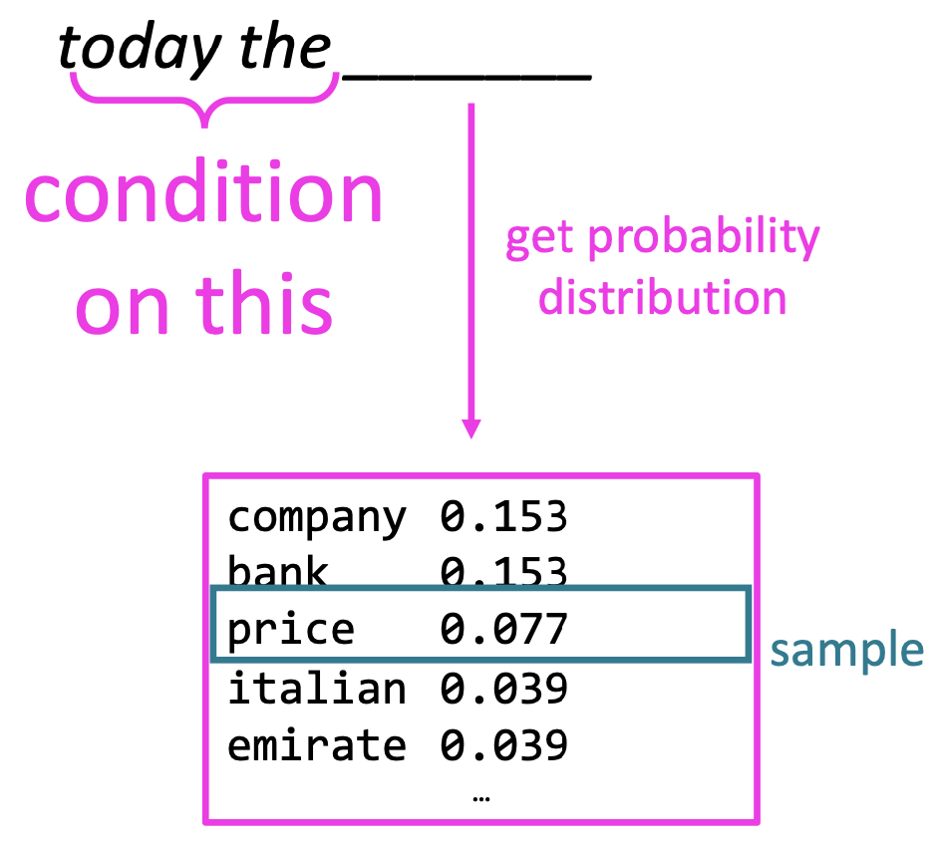
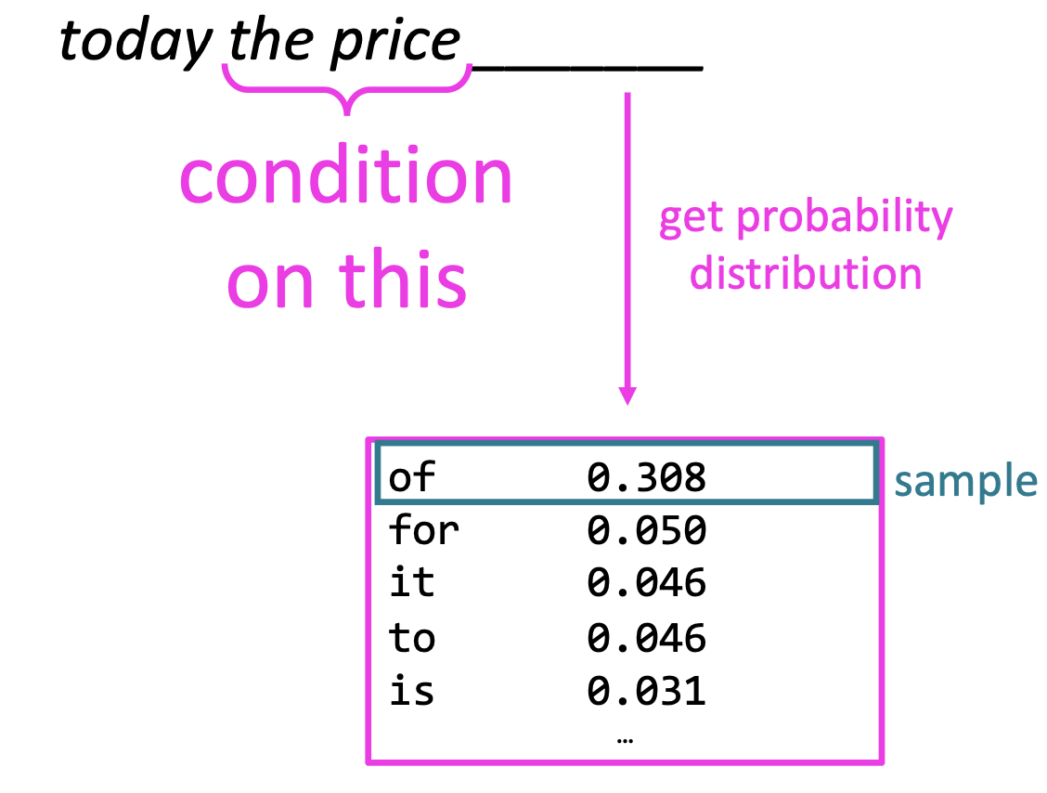
Generative text with an n-gram LM
You can use a LM to generate text
“today the price of gold per ton , while production of shoe lasts and shoe industry , the bank intervened just after it considered and rejected an imf demand to rebuild depleted european stocks , sept 30 end primary 76 cts a share.”
Surprisingly grammatical, but incoherent.
Increasing n would works better but worsens sparsity problem and increases model size

Slide 12
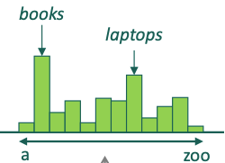

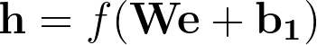

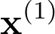
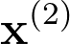
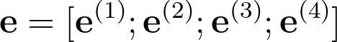
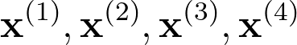
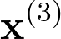
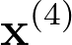
Fixed Window Neural LM
Y. Bengio, et al. (2000/2003): A Neural Probabilistic Language Model
No sparsity problem
Don’t need to store all observed n-grams
Remaining problems:
Fixed window is too small
Enlarging window enlarges W
In fact, window can never be large enough!
and are multiplied by completely different weights in W, allowing no interaction between words.
We need a neural architecture that can process any length input
the
students
opened
their

Slide 13
Recurrent Neural Networks

Slide 14
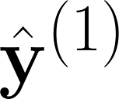
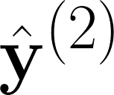
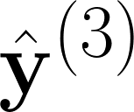
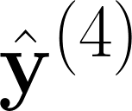
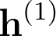
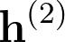
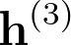
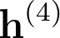
Recurrent Neural Networks (RNN)
Core idea: Apply the same weights W repeatedly
Outputs
(optional)
hidden
states
Input sequence (any length)

Slide 15
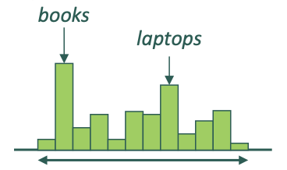
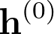
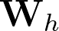

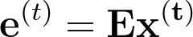
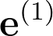
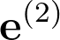
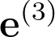
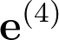
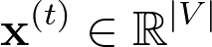

A simple RNN LM
output distribution
Can process any length input
Can use information from many steps back
Model size does not increase because W is shared
Remaining problems:
Recurrent computation is slow because it’s sequential
In reality, difficult to access information from many steps back (more on this later in the course)
hidden states
words embeddings
words/one-hot vectors

Slide 16
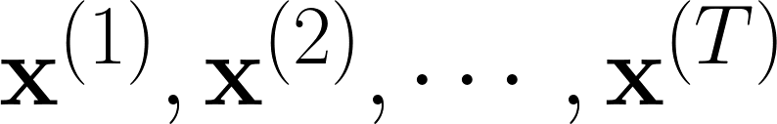
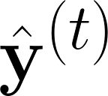
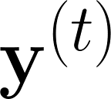
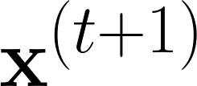
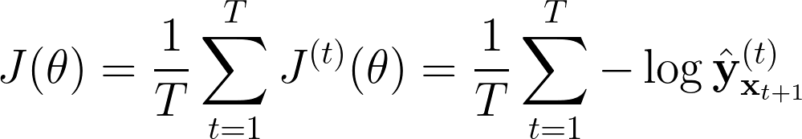
Training an RNN LM
Get a big corpus of text which is a sequence of words
Feed into RNN-LM; compute output distribution for every step t
i.e., predict probability dist of every word, given words so far
Loss function on step t is cross-entropy between predicted probability distribution , and the true next word (one hot for ):
Average this to get overall loss for the entire training set

Slide 17
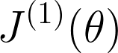
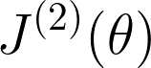
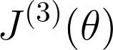

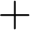
Training an RNN LM
Cross entropy between predicted word and “their”
Loss
Predicted prob dists.
This way of training is called “Teacher forcing”
Corpus
the
students
opened
their
exams

Slide 18

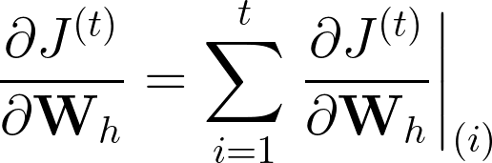
Training an RNN LM - more details
Better to perform stochastic gradient descent instead to save computational time
Use batch of sentences, instead of the whole corpus
The derivative w.r.t the repeated weight matrix is simply the sum of all gradients of each time step
This is also known as “backpropagation through time”

Slide 19
RNN LM - generating text
The word “is” will be fed as . The whole generation process can end when the desired length is reached, or we can also set to end when reaching <END> token.
This sampling process is called “decoding”, which has many approaches, e.g., random, top-k, top-1, beam-search, etc. We shall cover this later in our course.
the
boy
is
happy
sample
sample
sample
sample
RNN-LM can generate text by repeated samplings.
Note that this is NOT in training mode (i.e., teacher forcing) but inference/testing mode.
If we want to generate purely from scratch, during training, we need to append <START> and <END> token so that the model know what words are usually in the beginning or ending of a sentence
<START>
the
boy
is
happy

Slide 20
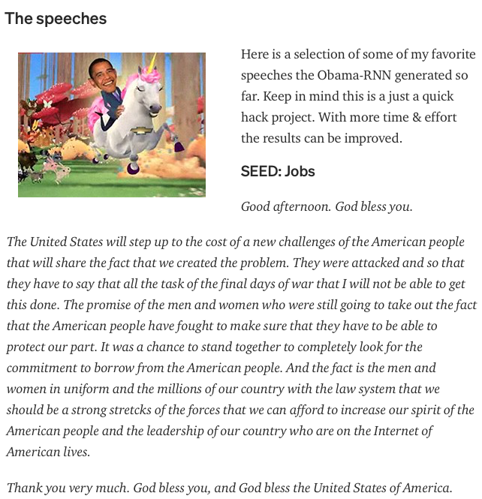
RNN LM - generating text
Obama speeches
https://medium.com/@samim/obama-rnn-machine-generated-political-speeches-c8abd18a2ea0

Slide 21

RNN LM - generating text
Let’s try some harry potter theme
https://medium.com/deep-writing/harry-potter-written-by-artificial-intelligence-8a9431803da6
“The Malfoys!” said Hermione.
Harry was watching him. He looked like Madame Maxime. When she strode up the wrong staircase to visit himself.
“I’m afraid I’ve definitely been suspended from power, no chance — indeed?” said Snape. He put his head back behind them and read groups as they crossed a corner and fluttered down onto their ink lamp, and picked up his spoon. The doorbell rang. It was a lot cleaner down in London.

Slide 22
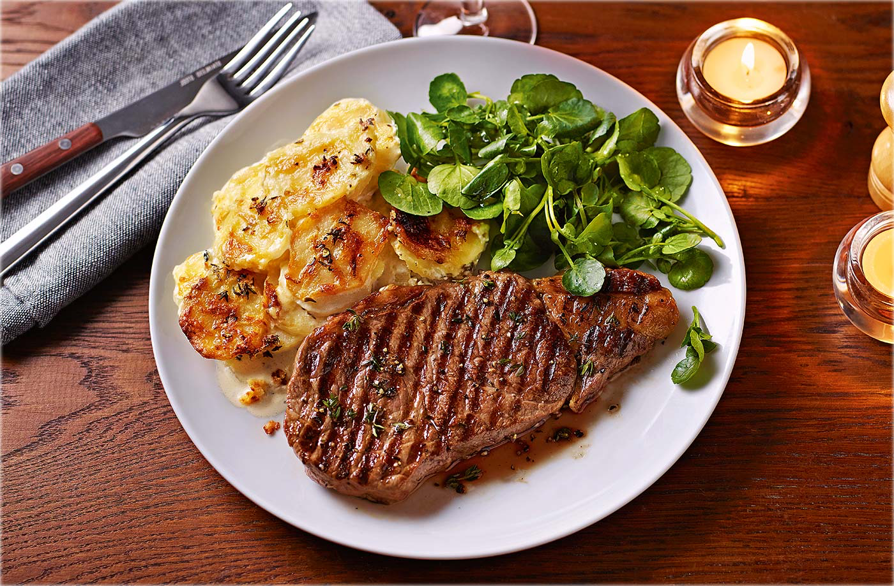
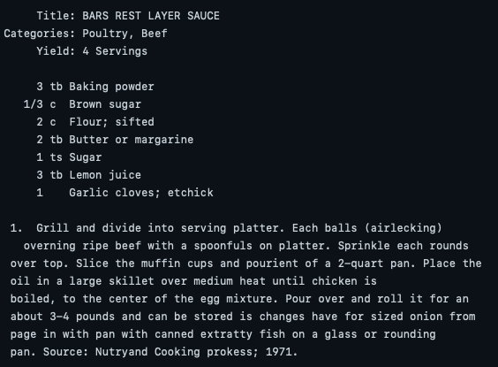
RNN LM - generating text
Let’s try some recipes
https://gist.github.com/nylki/1efbaa36635956d35bcc

Slide 23
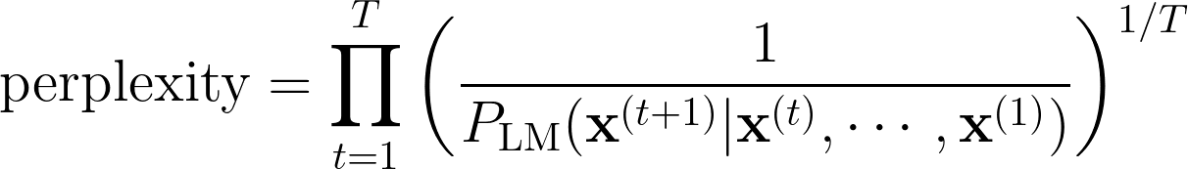
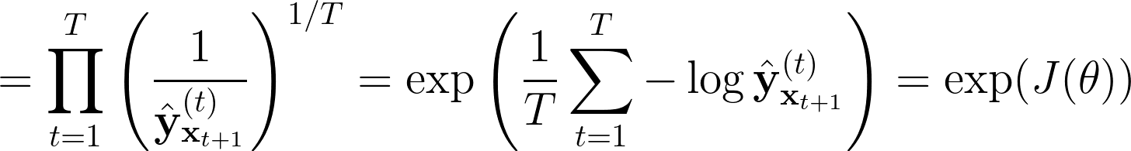
Evaluation of LM
The standard evaluation metric for LM is perplexity (lower better!)
Equal to the exponential of the cross-entropy loss
normalization factor

Slide 24
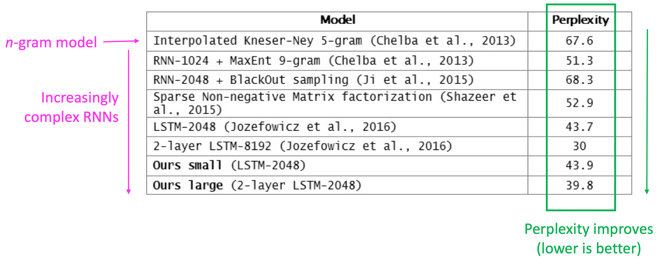
RNN has improved perplexity
https://research.fb.com/building-an-efficient-neural-language-model-over-a-billion-words/

Slide 25
RNN is NOT LM - POS Tagging, NER
RNN can be useful for many purposes, e.g., POS tagging, NER
DT
JJ
NN
VBN
the
frightened
cat
jumped

Slide 26
RNN is NOT LM - Sentiment Analysis
RNN can be useful for many purposes, e.g., sentiment analysis
Negative
Basic way is to use the final hidden state, and then simply project to 1
the
frightened
cat
jumped

Slide 27
RNN is NOT LM - Sentiment Analysis
Negative
RNN can be useful for many purposes, e.g., sentiment analysis
A better way for NLP is to usually use the element-wise mean or max of all hidden states, and then simply project to 1
the
frightened
cat
jumped

Slide 28
RNN is NOT LM - QA
Answer: German
RNN can be useful for many purposes, e.g., question answering
RNN serves as encoder for the question
Many possible architectures for the dotted line
Context: Ludwig van Beethoven was a German composer and pianist. A crucial figure ….
Question:
what
nationality
is
Beethoven

Slide 29
Terminology
RNN in this lecture = simple/vanilla/Elman RNN
More variants of RNN (all interchangeable)
LSTM
GRU
Stacked LSTM
Stacked Bidirectional LSTM
Stacked Bidirectional LSTM with attention
Stacked Bidirectional LSTM with attention with residual connections
Next lecture!

Slide 30
Summary
LM: a system that predicts the next word
Can be used for generating text
Not easy to notice that it’s a benchmark task because is a subcomponent of so so many NLP tasks
A n-gram LM suffers from sparsity and size problems
RNN
Takes any length input
Apply same weights
Can product output on each step
RNN is NOT LM, RNN are actually even more useful!
POS tagging,
Sentence classification,
Question answering,
...

